Slide 1
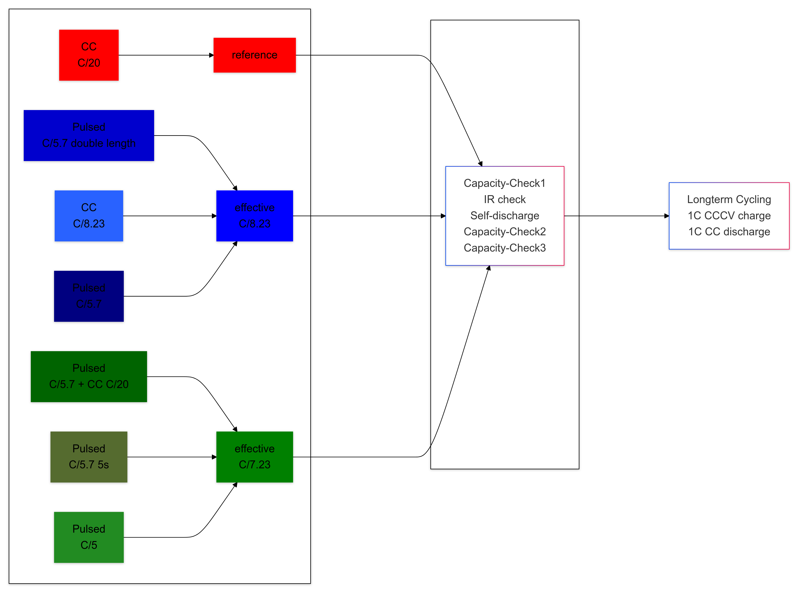
Formation
EOL-Test

Slide 2
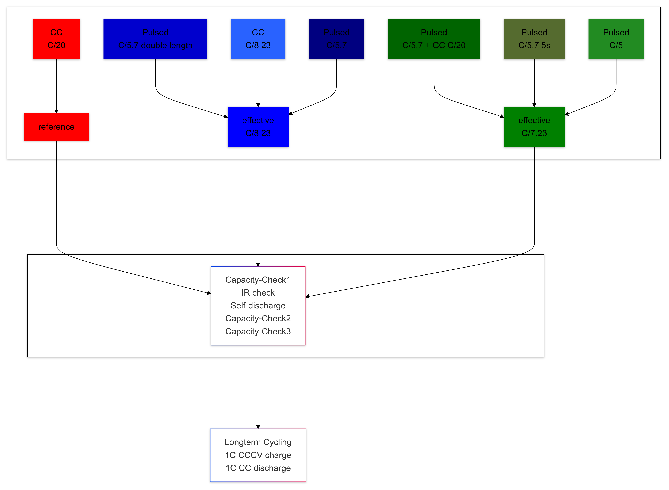
Formation
EOL-Test

Slide 3
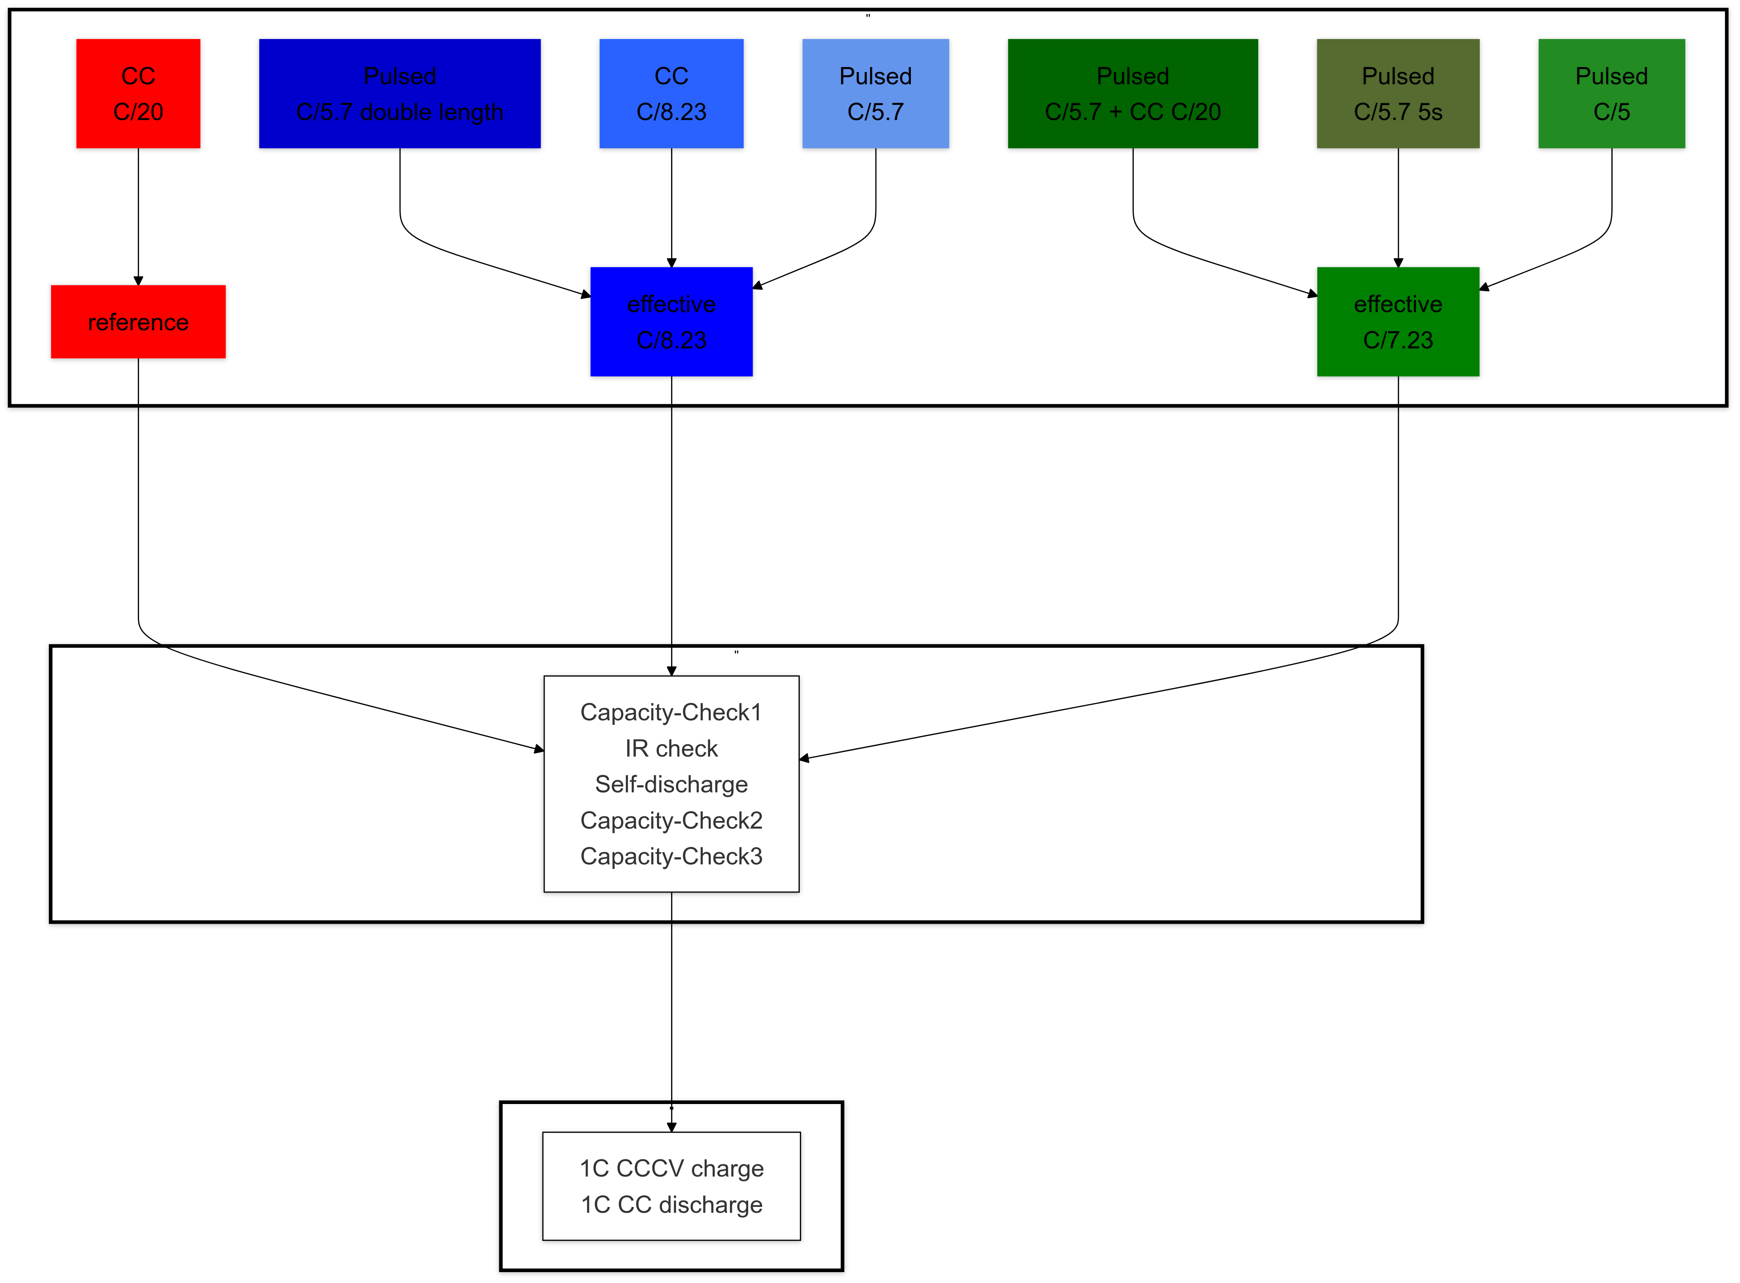
Formation
EOL-Test
Longterm Cycling

Slide 4
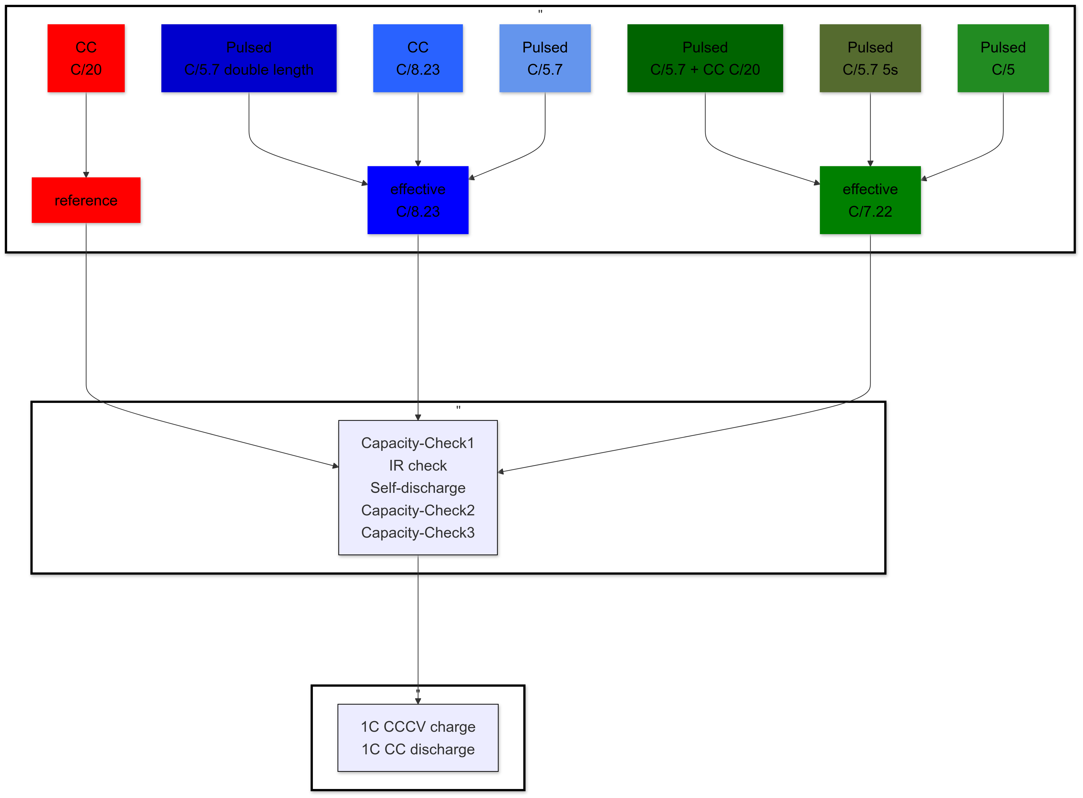
Formation
EOL-Test
Longterm Cycling

